Slide 1
What we will cover (13.30 - 14.40) Session 1 – Understanding the SQE
Topic | Speaker | Duration
SQE facts and stats | Julie Swan, Director of Education and Training (Chair) | 5 mins
A deeper dive into the SQE data | Richard Hankins, Quality and Standards Director, Kaplan Assessments | 25 mins
Design Principles for SQE1 and SQE2 | Tim Maddison, Legal Academic Director, Kaplan SQE | 25 mins
SQE evaluation | Beverley Rizzotto, Policy Manager, SRA | 15 mins

Slide 2
What we will cover (15.15 – 16.15) Session 2 – Supporting aspiring solicitors
Topic | Speaker | Duration
Introduction | Julie Swan, Director of Education, SRA (Chair) | 2 mins
The SQE training market | Richard Williams, Policy Manager, SRA | 15 mins
LPC route and transitional arrangements | Julie Swan, Director of Education, SRA (Chair) | 8 mins
QWE: Myth busting | Richard Williams, Policy Manager, SRA | 15 mins
Apprenticeships in practice | Kerry Gilbert, Early Careers Manager – Apprenticeships, TLT LLP | 20 mins

Slide 3
SQE facts and stats
24,090 candidates have passed SQE1
Of all candidates who have entered SQE1, 66% have passed
11,761 candidates have passed SQE2
Of all candidates who have entered SQE2, 85% have passed
The SQE1 pass rate for solicitor apprentices is 73%, across all who have received results to date
The SQE2 pass rate for solicitor apprentices is 94%, across all how have received results to date

Slide 4
A deeper dive into the data
Dr Richard Hankins
Quality and Standards Director, Kaplan

Slide 5
Reports by window
Reports include statistics that provide some feedback on the assessments and their performance
https://sqe.sra.org.uk/reports

Slide 6

Candidate characteristics data
Report that looks at the characteristics of SQE candidates and factors that influence scores in the SQE
It highlights the impacts of diversity, socio‑economic background and academic history
https://sqe.sra.org.uk/reports

Slide 7
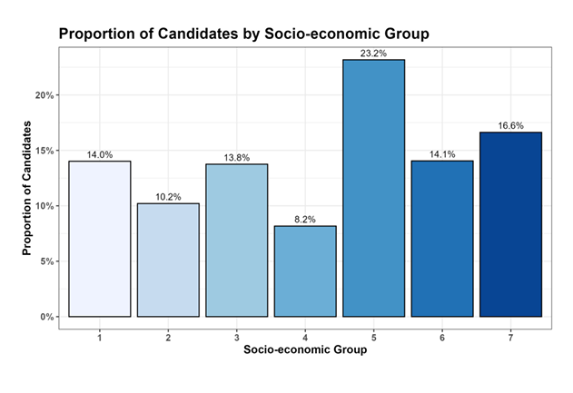
Socio-economic spread

Slide 8
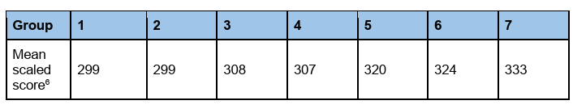
Scores by socio-economic group

Slide 9
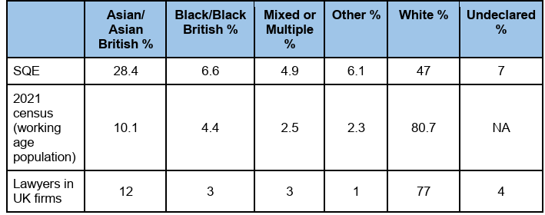
Engagement by ethnicity

Slide 10
Design Principles for SQE1 and SQE2
Tim Maddison, Legal Academic Director, Kaplan Assessments

Slide 11
Aims of the session
Provide a reminder of the design principles behind SQE1 and SQE2
Focus on the use of single best answer multiple choice questions in SQE1

Slide 12
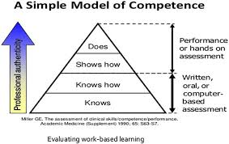
Design Principles: Miller’s Pyramid

Slide 13
Miller’s Pyramid and SQE1
SQE1: application of legal knowledge
'Knows how'
Statement of Solicitor Competence:
Maintain a level of legal knowledge
Draw on a sufficient detailed knowledge and understanding of their field(s) of work
Use … a broad base of legal knowledge….and detailed knowledge of their practice area.
Authenticity?

Slide 14
Miller’s Pyramid and SQE2
SQE2: legal skills (written and oral)
16 stations
'Shows how'
Statement of Solicitor Competence
Authenticity?

Slide 15
What are single best answer multiple choice questions?
Single best answer (SBA) multiple choice questions (MCQs) are used in SQE1 to assess candidates’ ability to apply their legal knowledge.
The questions do not assess simple recall
They assess a candidate’s ability to apply their knowledge to a relevant scenario
The scenarios reflect the type of matter a newly qualified solicitor might come across in practice.
There are three components to each question:
1. The stem, which sets out the scenario.
2. The lead in, which sets out the question to be answered.
3. The five options. Each of the five options is plausible, but only one is correct.

Slide 16
Who writes the questions?
Solicitors
Minimum of two (usually three) solicitor subject matter experts
Further review by two more solicitors
SRA solicitor subject matter expert review
Each question involves a minimum of four, usually five, solicitors.

Slide 17
Why are they appropriate for high stakes professional assessment?
SBAs are a well-established method of assessing the application of knowledge:
Standardised scoring: single correct answer
Quick and accurate marking of a large number of candidates
Effectively sample a wide breadth of a curriculum
Assessment of high order thinking
Test security
Removes the need for written expression

Slide 18
What are the alternatives?
Essays
Short answer questions
Extended match questions
Long answer questions
Role play

Slide 19
Where else are they used?
Accountancy:
Institute of Chartered Accountants in England & Wales
Chartered Institute of Management Accountants
Association of Chartered Certified Accountants
Chartered Financial Analysts
Medicine:
GMC Medical Licensing Assessment (MLA)
Royal College of Psychiatrists
Royal College of Anaesthetists
Royal College of Emergency Medicine
Faculty of Intensive Care
Royal College of GPs
Royal College of Surgeons
GMC Professional Linguistic Assessment Board Test
Law:
National Conference Bar Examiners - Multistate Bar Exam
Bar Standards Board (Civil and Criminal)
All India Bar Exam
China's Unified Legal Professional Qual Exam
New York Bar Exam
Canadian Bar Exam
Spanish Bar Exam

Slide 20
Should they be the only method of assessment?

Slide 21
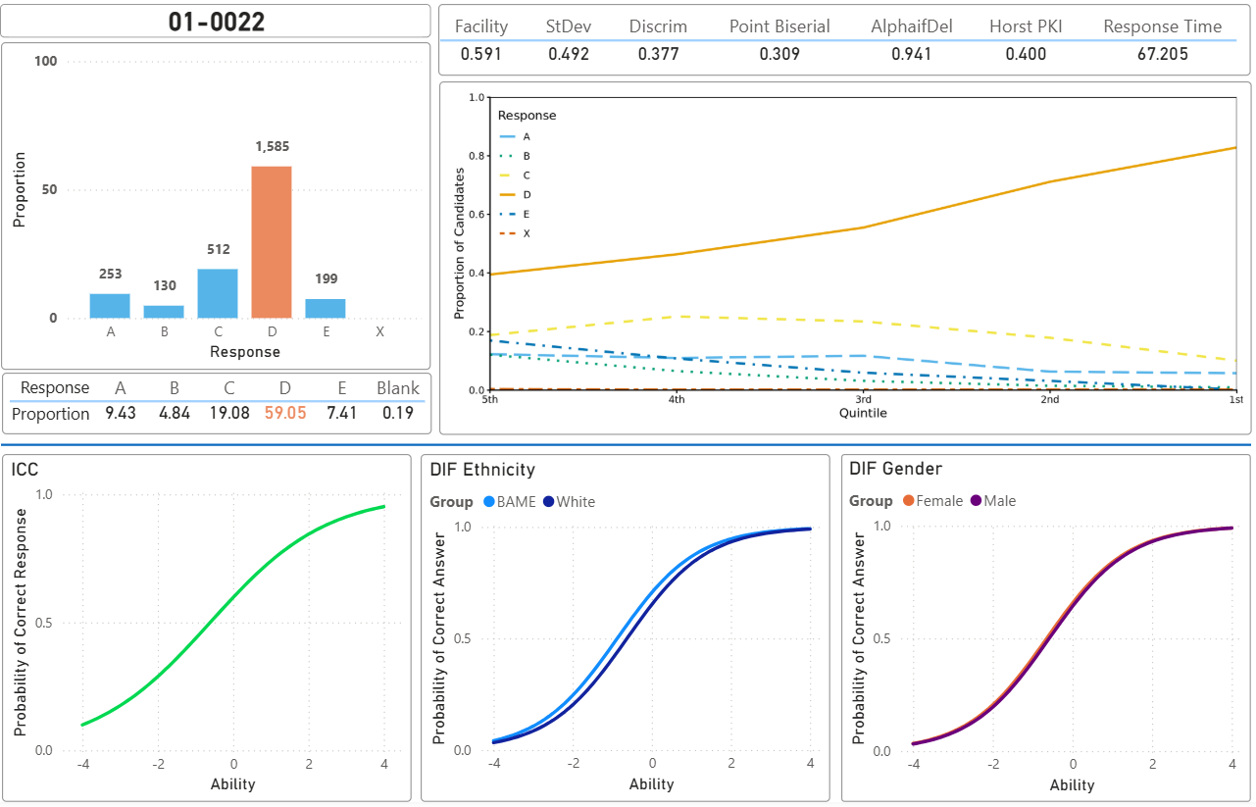
Are single best answer MCQs fair?

Slide 22
SQE1: single best answer MCQs
Are single best answer MCQs perfect?
'Cuing' effect?
Ability to guess
How can you mitigate this?
Question writing process
Review the data

Slide 23
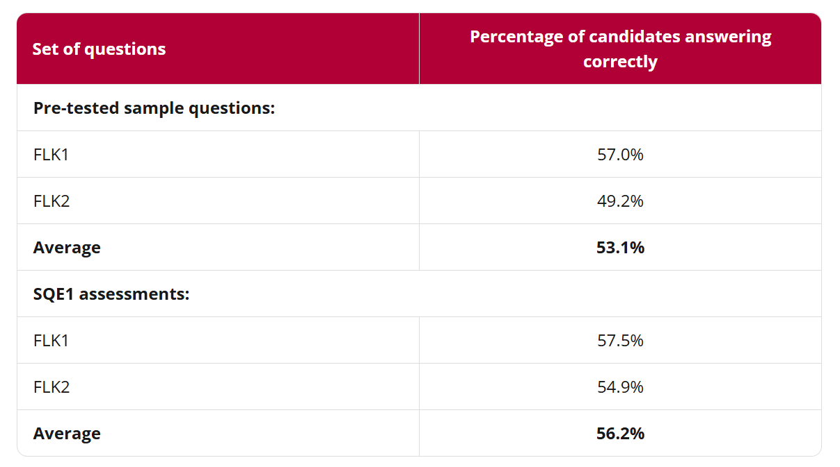
Where can I take a look at some?
220 SQE1 sample questions
130 have been used in SQE1 assessments
Data on difficulty and length provided
https://sqe.sra.org.uk/assessments/sqe1-assessments/sqe1-sample-questions

Slide 24
Where can I find out more?
Information on the purpose of SBAs, including why this format is used to test applied legal knowledge.
Breaks down how the questions work, outlining their structure and how candidates should approach them.
Describes the benefits of SBA assessments, such as fairness, reliability and their use across high‑stakes professional exams.
https://sqe.sra.org.uk/assessments/sqe1-assessments/sqe1-single-best-answer

